Slide 1


Digital Citizenship

Slide 2



What is digital citizenship?
Digital Citizenship: Navigating the digital world safely, responsibly, and ethically
(http://www.commonsensemedia.org/educators/lesson/digital-life-102-9-12)

Slide 3






What is a digital media?
Digital Media: Electronic devices and media platforms such as computers, cell phones, video, social networking sites, the Internet, and video games that allow users to create, communicate, and interact with one another or with the device or application itself.

Slide 4


Life in a Connected Culture
Watch the following video:

Slide 5



Digital Footprint
Watch the following video1

Slide 6
Digital Footprint
Watch the following video2

Slide 7
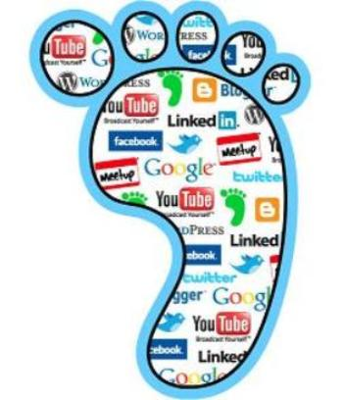

What are digital footprints?
Well, you may not realize it BUT every time you go online you leave a trail!! Have a look in the history section of your website browser and you can see the websites you have visited in the past.
http://www.kidsmart.org.uk/digitalfootprints/
yourdigitalfootprints.com

